Slide 1
About Me
Ritesh Singh
Sun Certified java Professional
Oracle Certified Database Administrator
Certified Ethical Hacker
Certified EC-Council Instructor (CEI)

Slide 2
Course Overview
Introduction MySQL DELETE JOIN statement.

Slide 3
MySQL DELETE JOIN with INNER JOIN
MySQL also allows you to use the INNER JOIN clause in the DELETE statement to delete rows from a table and the matching rows in another table.
For example, to delete rows from both T1 and T2 tables that meet a specified condition, you use the following statement:
DELETE T1, T2
FROM T1
INNER JOIN T2 ON T1.key = T2.key
WHERE condition;

Slide 4
Notice that you put table names T1 and T2 between the DELETE and FROM keywords. If you omit T1 table, the DELETE statement only deletes rows in T2 table. Similarly, if you omitT2 table, the DELETE statement will delete only rows in T1 table.
The expression T1.key = T2.key specifies the condition for matching rows between T1 andT2 tables that will be deleted.
The condition in the WHERE clause determine rows in the T1 and T2 that will be deleted.

Slide 5
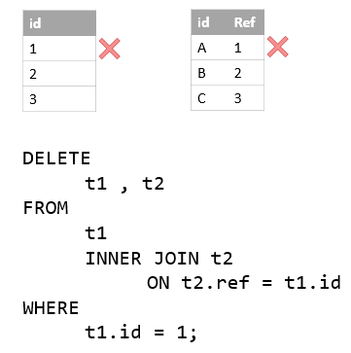
MySQL DELETE JOIN with INNER JOIN example
Suppose, we have two tables t1 and t2 with the following structures and data:
DROP TABLE IF EXISTS t1, t2;
CREATE TABLE t1 (
id INT PRIMARY KEY AUTO_INCREMENT
);
CREATE TABLE t2 (
id VARCHAR(20) PRIMARY KEY,
ref INT NOT NULL
);
INSERT INTO t1 VALUES (1),(2),(3);
INSERT INTO t2(id,ref) VALUES('A',1),('B',2),('C',3);

Slide 6
The following statement deletes the row with id 1 in the t1 table and also row with ref 1 in the t2 table using DELETE...INNER JOIN statement:
DELETE t1,t2 FROM t1
INNER JOIN
t2 ON t2.ref = t1.id
WHERE
t1.id = 1;
The statement returned the following message:
2 row(s) affected
It indicated that two rows have been deleted.

Slide 7
MySQL DELETE JOIN with LEFT JOIN
We often use the LEFT JOIN clause in the SELECT statement to find rows in the left table that have or don’t have matching rows in the right table.
We can also use the LEFT JOIN clause in the DELETE statement to delete rows in a table (left table) that does not have matching rows in another table (right table).
The following syntax illustrates how to use DELETE statement with LEFT JOIN clause to delete rows from T1 table that does not have corresponding rows in the T2 table:
DELETE T1
FROM T1
LEFT JOIN
T2 ON T1.key = T2.key
WHERE
T2.key IS NULL;
Note that we only put T1 table after the DELETE keyword, not both T1 and T2 tables like we did with the INNER JOIN clause.

Slide 8
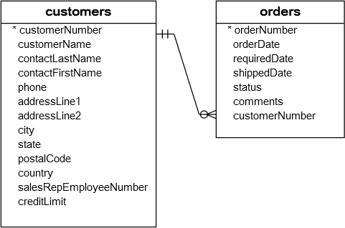
MySQL DELETE JOIN with LEFT JOIN example
See the following customers and orders tables in the sample database:

Slide 9
Each customer has zero or more orders. However, each order belongs to one and only one customer.
We can use DELETE statement with LEFT JOIN clause to clean up our customers master data. The following statement removes customers who have not placed any order:
DELETE customers
FROM customers
LEFT JOIN
orders ON customers.customerNumber = orders.customerNumber
WHERE
orderNumber IS NULL;

Slide 10
We can verify the delete by finding whether customers who do not have any order exists using the following query:
SELECT
c.customerNumber,
c.customerName,
orderNumber
FROM
customers c
LEFT JOIN
orders o ON c.customerNumber = o.customerNumber
WHERE
orderNumber IS NULL;
The query returned an empty result set which is what we expected.

Slide 11
Thank You
Please Subscribe My Channel
https://www.youtube.com/channel/UCYW3PWPOPn3qgxxjhUbXXXg?view_as=subscriber

